Slide 1
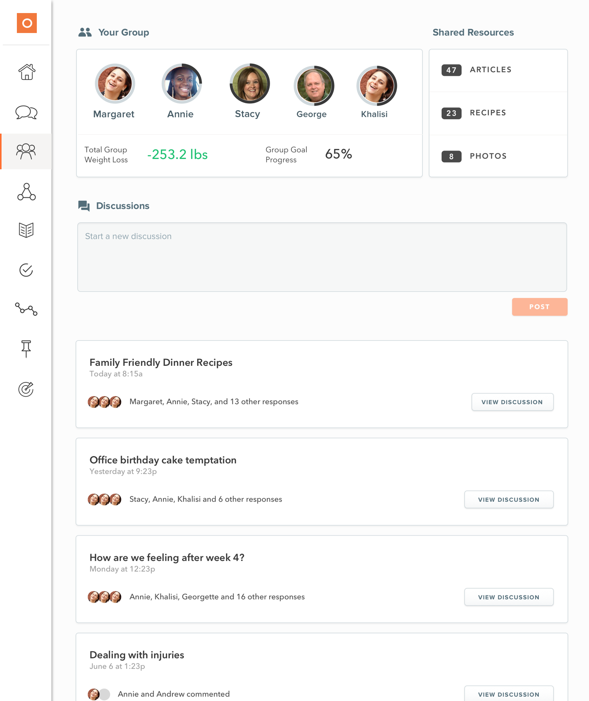
Omada®
Diabetes Prevention and Hypertension Management Solutions
Personal health coach for one-on-one guidance
Small, private group of participants for support
Services covered as preventive with no out-of-pocket cost
INTERACTIVE LESSONS
DATA SCIENCE
SUPPORT
GROUP
SMART TECHNOLOGY
PROFESSIONAL HEALTH COACH
Omada is an independent company that provides chronic disease prevention solutions for Blue Cross and ‭Blue Shield of Texas. Omada is solely responsible for the products and services that it provides.
Notes:
Approved 7/18/22 (by JL)
EMI Team – Johanna Hauki (was Therese Bellar), Debb Bastian
Content confirmed by Jessica LeBeau, Bill Manganaro
Obesity-Related Chronic Disease Prevention
Digitally delivered, evidence-based behavioral modification program
Personal health coach for one-on-one guidance
Weekly, interactive online lessons to educate and inspire
Wireless scale uploads weigh-ins to a private portal and viewable by your personal coach
Small, private group of participants for support
Hypertension Management
Twelve months of interactive courses plus ongoing support
Proactive coaching guidance throughout the program and remote monitoring of blood pressure values
Hypertension-specific grouping creates safe space where participants can provide social support to one another

