Slide 1
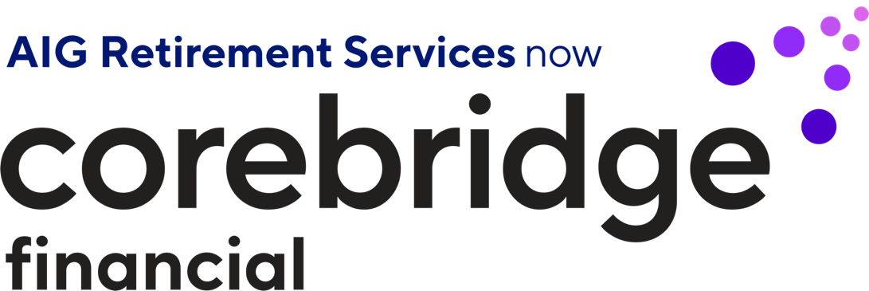

Slide 2
What makes Corebridge Financial different?
+
Core
Speaks to our strong foundation of industry-leading products, services and partnerships that are central to helping people take action in their financial lives.
Bridge
Evokes our passion for helping people take action to carry them from planning to outcomes, providing a path from today’s financial needs to tomorrow’s aspirations.
Notes:
What makes Corebridge Financial different?
Core Speaks to our strong foundation of industry-leading products, services and partnerships that are central to helping people take action in their financial lives
Bridge Evokes our passion for helping people take action to carry them from planning to outcomes, providing a path from today’s financial needs to tomorrow’s aspirations.

Slide 3
Helping your employees take action
Experts all-in
on your
success
Simple and intuitive digital experiences
Individual journeys and personal relationships
Notes:
Many of you are aware that we’ve been working to transition to Corebridge Financial for some time. We are pleased to announce that we had a successful IPO in September—and we couldn’t be more excited.
One of the positive outcomes: Not only a new name but a new brand identity. For us, it’s all about helping employees take action—period.
In fact, action is everything is our new brand. And we are really excited about how that positions us.
When you think of Corebridge and how we want you consider us, it really comes down to three things.
The first is, we are experts—all in on your success. I’ll come back to that in a second.
Second, we have simple and intuitive digital experiences.
And lastly, for us, it’s all about individual journeys and personal relationships.
Now let’s take a closer look at these three points.
Experts all in on your success. What does that mean? We recognize this is a complex time for all of you as you evaluate providers—including Corebridge Financial. When we say experts all in on your success, here’s what that means.
We have a very deliberate approach around the markets we serve.
We focus on five markets—we don’t chase the $7 trillion 401(k) market. That’s not where we spend time.
We focus on retirement plans for healthcare, government, higher education, K-12 and other non-profits such as religious and charitable organizations.
In fact, 65 years ago, we wrote the first ever 403(b) plan, and that Florida client is still our client today.
In other words, we serve those who serve others.
The expectation when you work with us based on our experience and expertise in those five very distinct and select markets—is you’re going to get the best from our team. You’re going to get experts who understand these markets and what it’s like to be in the public sector. And we have a unique way in which we engage them.
Simple and intuitive digital experiences is just that. What does simple and intuitive digital experiences mean? It means our tools are easy to use. In fact, our website has consistently been recognized again by DALBAR with a 2Q22 #1 Ranking for Behavior Centricity Website for Retirement Services.
Our mobile application, participant experiences and plan sponsor experiences—like SponsorFIT—gives you as the administrator an opportunity to engage with us in a simple manner that gives you the results and outcomes you need.
Lastly, with individual journeys and personal relationships, we have this incredible intersection of financial professionals and simple and intuitive digital experiences. It’s our differentiator. It’s how we distinguish ourselves from others.
We provide flexibility to you as a plan sponsor, but we will be prescriptive—because after all, we’re experts.
We look at the makeup and construct of your plan—what you are trying to achieve with your participants—whether it’s about an increase of enrollment, increase of engagement or better outcomes.
The bottom line is that with Corebridge your employees receive valuable education, advice and guidance however and whenever they prefer. Access to our trusted financial professionals delivers the personal touch many employees need to take action.

Slide 4
Corebridge Financial
Strength and experience
$357B in retirement assets¹
Serving more than 22,000
plan sponsors across 50 states²
60+ years of retirement experience²
1,300
career financial professionals serving employees & participants²
¹ Assets Under Management/Administration (as of 3/31/23) excludes Retail Mutual Funds and the Life Insurance business. In addition, Institutional Markets comprises the national value of stable value wrap contracts only, excluding the portion included in total insurance reserves.
² As of 6/30/22
Notes:
For over 60 years, we’ve helped millions of Americans turn their vision for retirement into reality. That’s why so many plan sponsors and employees continue to place their trust in us year after year. The average length of our relationships with plan sponsors is nearly 30 years, and one in four in-plan individual clients have been with us for more than 20 years.
We are a leading retirement plan provider for K-12 schools, healthcare, government, higher education and other not-for-profit institutions. Through our strong partnerships with plan sponsors and consultants, a dedicated financial advisor network, and innovative technology solutions and tools, we make retirement planning easy and accessible and help people turn their financial dreams into realities.
We have a long history in the nonprofit DC businesses. Our commitment to the marketplace is stronger than ever:
Corebridge Financial, previously AIG Life & Retirement, wrote the very first 403(b) plan for a public school district in 1964: –Dade County, Florida.
We’ve celebrated 50-year anniversaries with a number of plans, and our long-term commitment to the educators, firefighters, public service employees, and government officials is why we’re in business.
Our mission drives us every day, in every aspect of our work: that every American deserves a secure, fulfilling retirement. We’re very excited about building on our legacy and providing the best products, solutions and expertise to our clients and partners, like you.

Slide 5
Simple and intuitive digital experiences
DALBAR 2Q22 #1 Ranking for Behavior Centricity Website for Participant Experience
Mobile
Custom participant website
Digital tools
Notes:
Think, for a moment, about how you see your employees interacting with the plan. Are they happy it was simple to enroll? Are they excited about meeting with a financial professional who took the time to get to know them? Did they increase their contribution rate because it was easy to understand the advantages? Did they tell their colleagues about how great it feels to have a plan for the future?
That’s what Corebridge delivers—positive encounters centered on individual experiences.
We provide your employees access to valuable education, advice and guidance however and whenever they prefer.
It’s no surprise that DALBAR has ranked our website among the best in the industry for participant experience.

