Slide 1
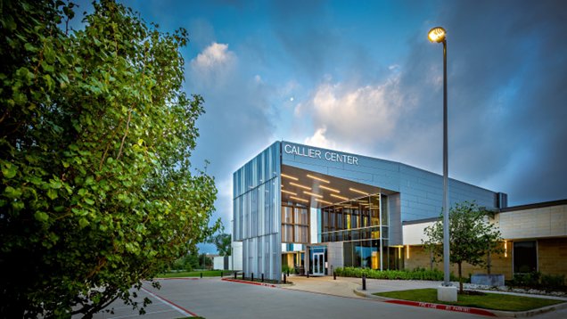
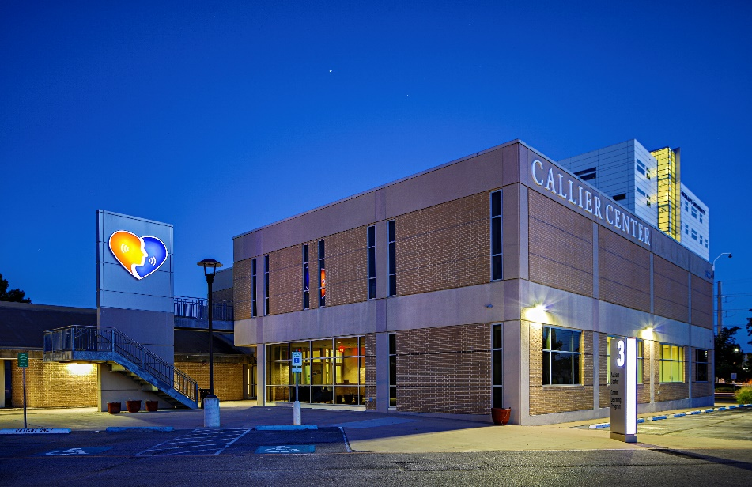
Celebrate May is Better Hearing & Speech Month at the Callier Center!
A NATIONAL CENTER OF EXCELLENCE!
Since 1963, the Callier Center for Communication Disorders has provided treatment, training, and research to help people of all ages hear, speak, and connect with others. Our team of licensed and certified audiologists and speech-language pathologists provides a continuum of evidence-based care that transforms the lives of patients and families impacted by communication disorders.
Callier Center Richardson
Callier Center Dallas

Slide 2

Hearing Benefits through UT Select and UT Care plans!
AUDIOLOGY SERVICES
Complete audiometric (hearing) evaluations for all ages (birth to older adults)
Hearing aids and services, including state-of- the-art individualized fitting and follow-up.
Tinnitus evaluation and management
Custom hearing protection devices for hunters, swimmers, musicians, and pilots
CALL NOW TO MAKE AN APPOINTMENT!
972-883-3630
UT Select, UT Care Plan Benefits
Exams to diagnose and treat hearing and balance issues
Routine hearing exams
$1000.00 per ear allowance for hearing aids every 3 years.

Slide 3
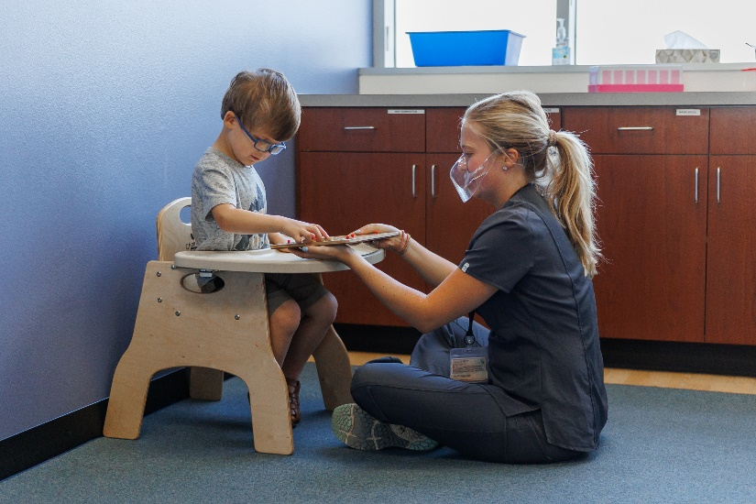
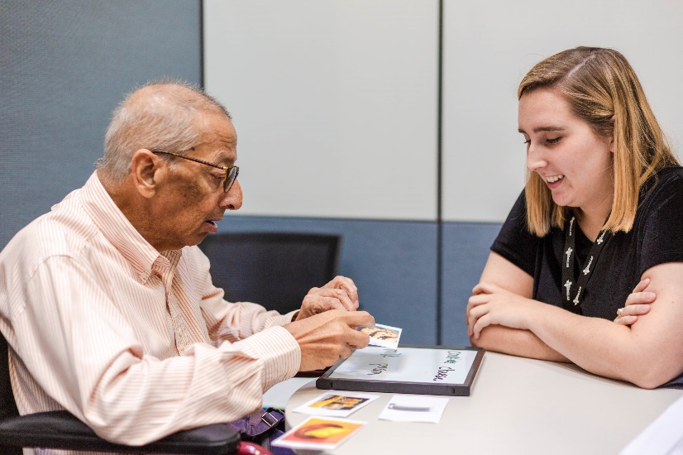
Providing Hearing & Speech-Language Services for All Ages!

